Slide 1
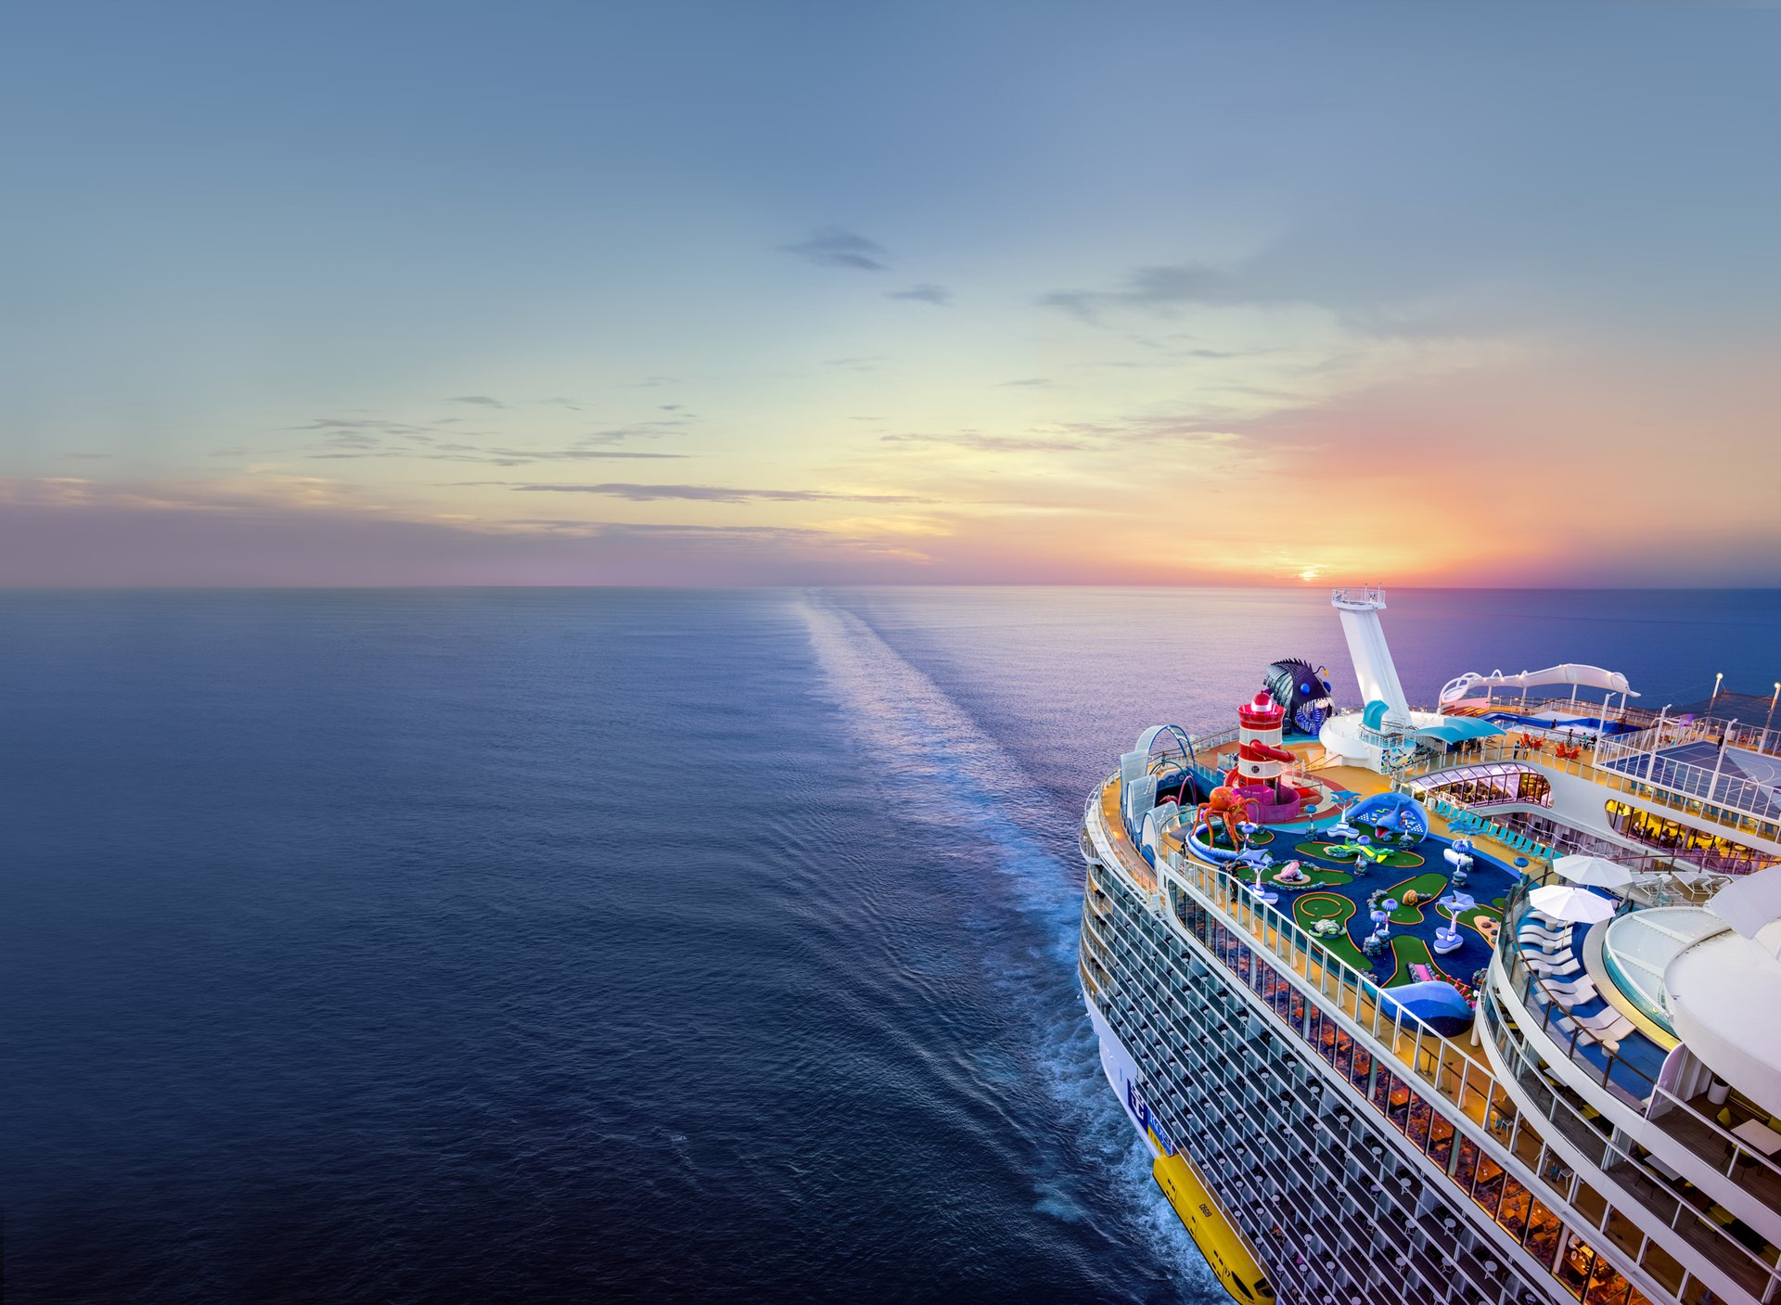
Ship Fuel Efficiency
& Emissions Analysis
Data Analytics Final Project —
Task 1: Problem Definition & Dataset Selection | Task 2: Data Cleaning & Pre-processing | Task 3: EDA & Visualizations| Task 4: Documentation, Insights & Presentation
START PRESENTATION »
CONTENT
END PRESENTATION
Aseem
Domain: Environmental / Maritime Operations Analytics
Dataset: ship_fuel_efficiency.csv • 1,440 trip records • 10 features

Slide 2
« PREV
START »
NAVIGATE — CLICK ANY TASK TO JUMP TO IT
Table of Contents
END PRESENTATION
01 Task 1 — Problem Definition & Dataset Selection
02 Task 2 — Data Cleaning & Pre-processing
03 Task 3 — EDA & Visualizations
04 Task 4 — Documentation, Insights & Presentation

Slide 3
« PREV
NEXT »
NAVIGATE — CLICK ANY TOPIC TO JUMP TO IT
Task 1
END PRESENTATION
01 Problem Statement
02 Domain & Dataset Selection

Slide 4
« PREV
NEXT »
NAVIGATE — CLICK ANY TOPIC TO JUMP TO IT
Task 2
END PRESENTATION
01 Data Loading & Initial Overview
02 Cleaning Checks
03 Derived Columns
04 Aggregation: Ship Type Summary
05 Summary & Next Steps

Slide 5
« PREV
NEXT »
NAVIGATE — CLICK ANY TOPIC TO JUMP TO IT
Task 3
END PRESENTATION
01 EDA Approach
02 Univariate Analysis
03 Bivariate Analysis
04 Multivariate Analysis

Slide 6
« PREV
NEXT »
NAVIGATE — CLICK ANY TOPIC TO JUMP TO IT
Task 4
END PRESENTATION
01 Headline Finding: Tanker Ships Drive Fuel & Emissions
02 Key Insights
03 Recommendations & Next Steps

Slide 7
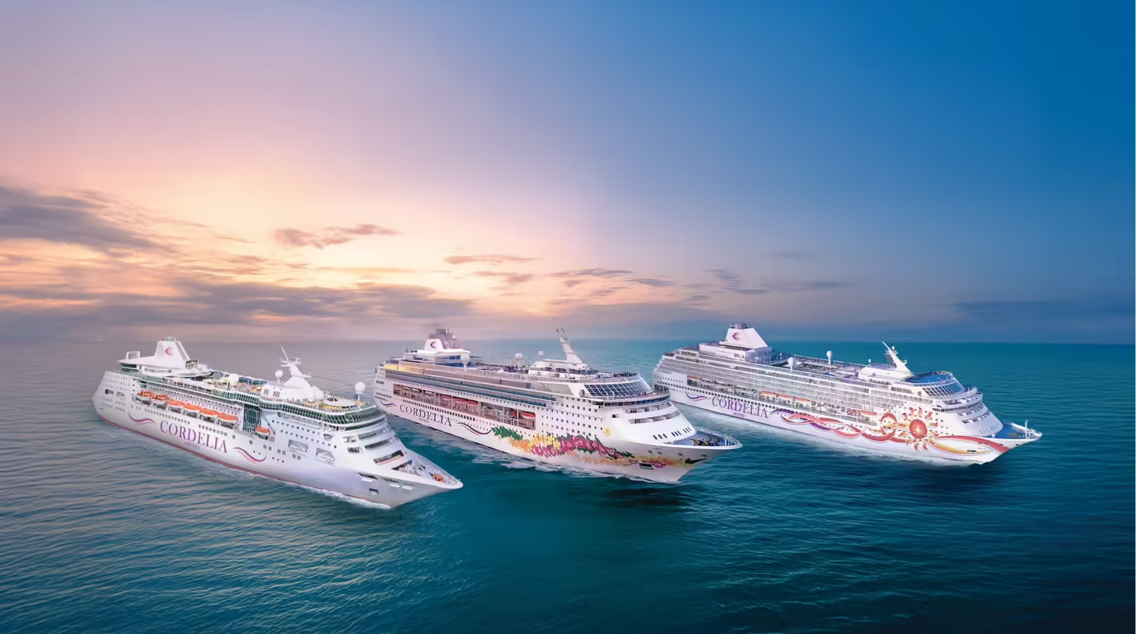
« PREV
CONTENT
NEXT »
Task 1a : Problem Statement
Fuel is the largest operating cost for a maritime fleet — and the main source of its CO₂ emissions.
This project analyzes 12 months of trip-level data to find out:
Which ship types & routes drive the most fuel use and CO₂ emissions?
How does weather affect fuel consumption and engine efficiency?
Does fuel type (HFO vs Diesel) change efficiency or emissions?
Is there a seasonal pattern in fuel use?
How are distance, fuel, CO₂, and efficiency related?
Supports route planning, fuel budgeting, and maintenance prioritization for fleet operators.
Why it matters
END PRESENTATION

Slide 8
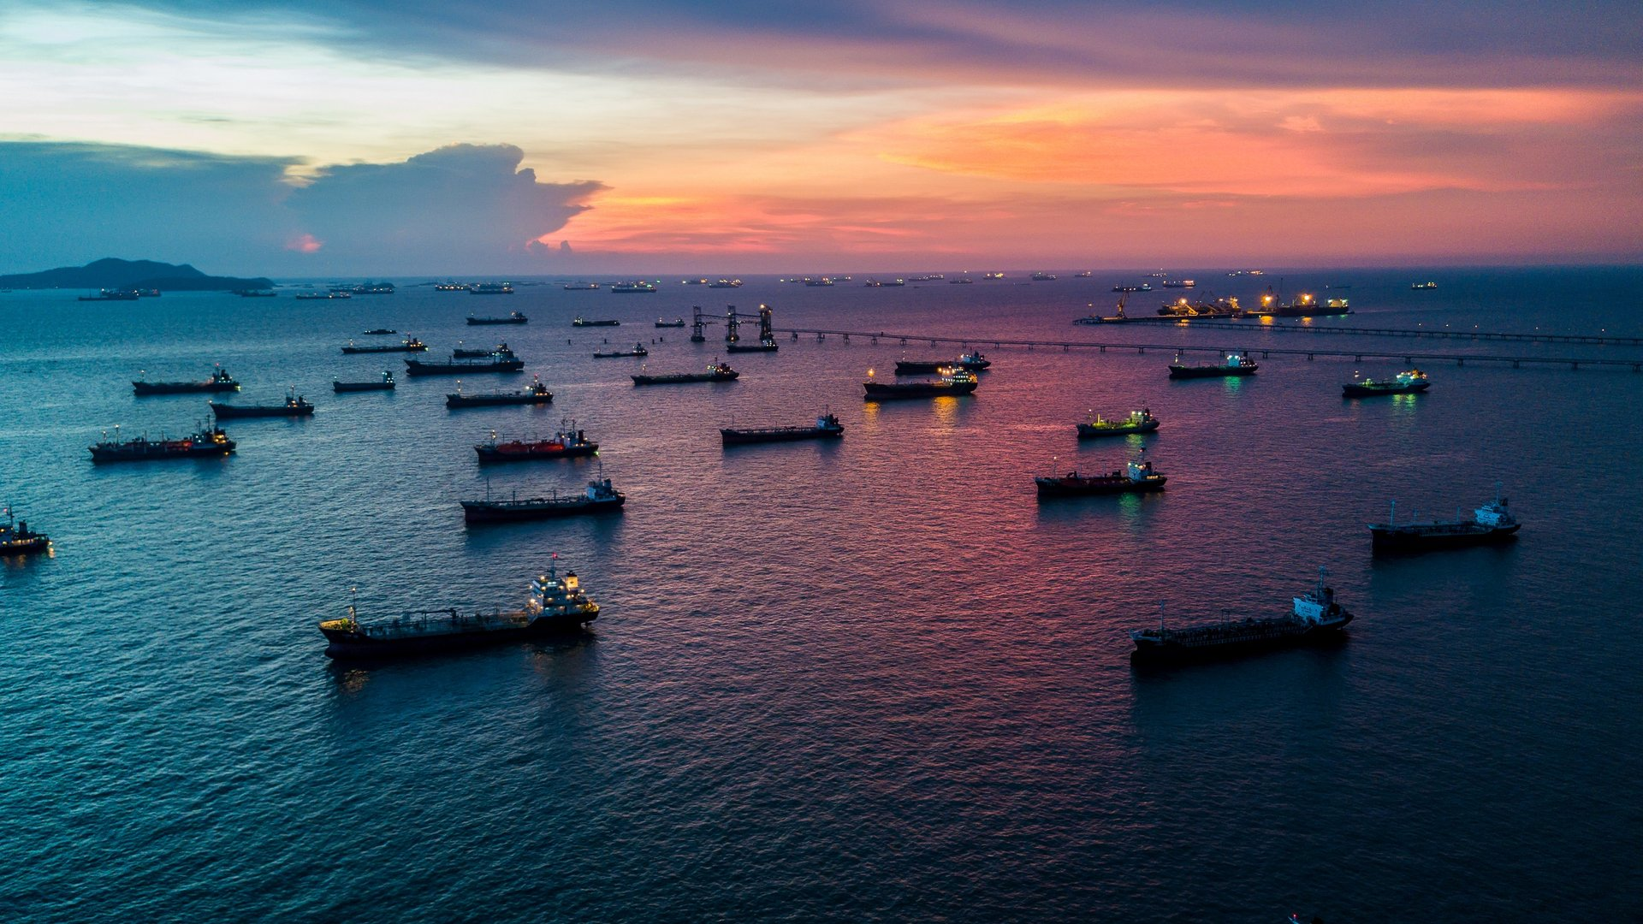
« PREV
CONTENT
NEXT »
Task 1b — Domain & Dataset Selection
Domain: Environmental / Operations
Dataset snapshot
Transportation and emissions monitoring — directly relevant to naval architecture and marine operations decision-making, connecting the coursework to my own background.
Ship types (4)
Oil Service Boat, Fishing Trawler,
Surfer Boat, Tanker Ship
Routes (4)
Warri-Bonny, Port Harcourt-Lagos,
Lagos-Apapa, Escravos-Lagos
Why this dataset qualifies
Fuel types (2)
HFO, Diesel
1,440 records (min. required: 500)
10 features (min. required: 10)
Mix of numeric (4) and categorical (6) columns
12 months of real trip-level history
Weather (3)
Calm, Moderate, Stormy
Numeric fields
distance, fuel_consumption,
CO2_emissions, engine_efficiency
END PRESENTATION

Slide 9
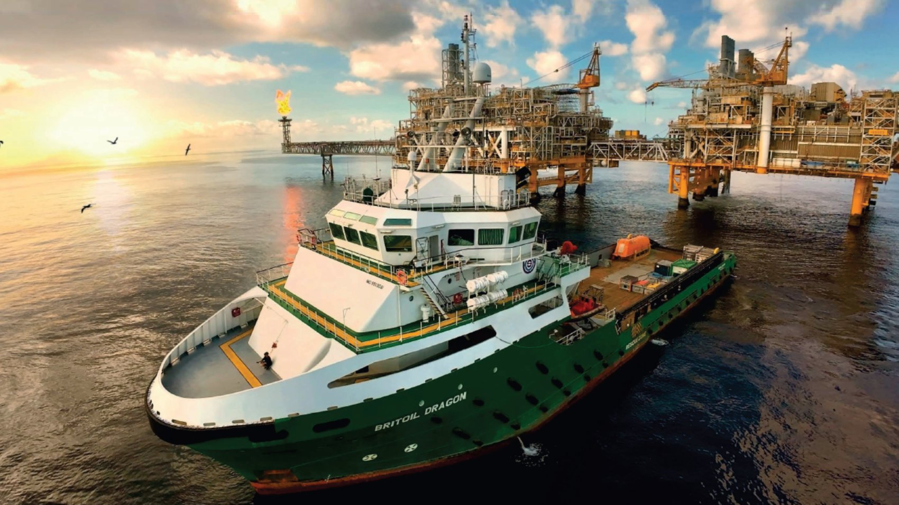
« PREV
CONTENT
NEXT »
Task 2a — Data Loading & Initial Overview
1,440
10
0
0
Rows
Columns
Missing values
Duplicate rows
Code used:
df = pd.read_csv("ship_fuel_efficiency.csv")
df.shape # (1440, 10)
df.head()
df.info()
df.describe() # numeric summary
df.describe(include='O') # categorical summary
END PRESENTATION

Slide 10

« PREV
CONTENT
NEXT »
Task 2b — Cleaning Checks
Domain: Environmental / Operations
What we checked
Result
df.isnull().sum() → 0 missing values in every column
df.duplicated().sum() → 0 duplicate rows
df[col].unique() on all 4 categorical columns → no case mismatches or typos (e.g. no 'hfo' vs 'HFO')
df.dtypes → all 4 numeric columns already float64, all text columns already text
This data pull arrived already clean.
No fillna(), no dropna(), and no .replace() clean-up were needed.
Running the checks explicitly — rather than assuming — is itself the deliverable the rubric asks for, and the same code would catch problems if a future data refresh isn't as clean.
END PRESENTATION

Slide 11

« PREV
CONTENT
NEXT »
Task 2c — Derived Columns
distance_per_fuel
distance / fuel_consumption
km covered per litre burned
co2_per_fuel
CO2_emissions / fuel_consumption
CO₂ emitted per litre burned
co2_per_distance
CO2_emissions / distance
CO₂ emitted per km travelled
season
dictionary + list comprehension on month
Winter / Spring / Summer / Autumn
Plus two groupby().agg() summary tables — by ship type, and by fuel type × season — ready to feed in visualizations session coming soon.
END PRESENTATION

Slide 12
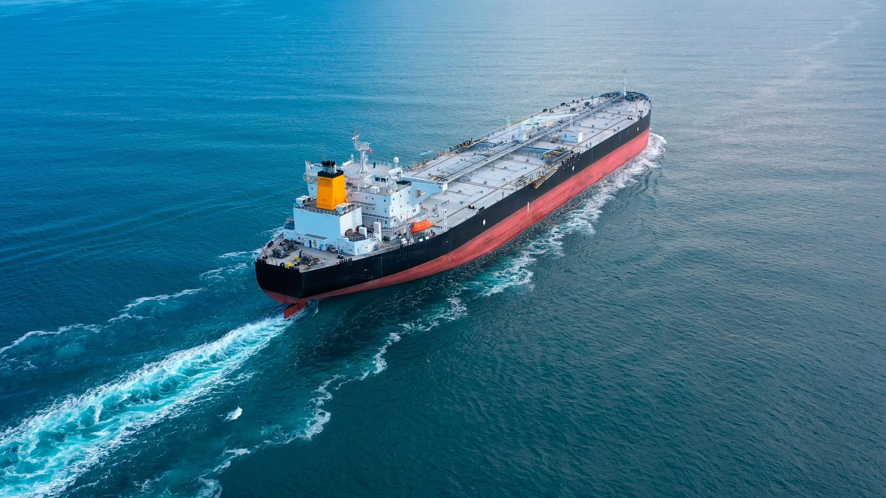
« PREV
CONTENT
NEXT »
Task 2d — Aggregation: Ship Type Summary
Ship Type | Trips | Avg Distance (km) | Avg Fuel (L) | Avg CO₂ (kg) | Avg Efficiency (%)
Tanker Ship | 408 | 266.76 | 10,780.41 | 29,795.44 | 82.18
Fishing Trawler | 300 | 127.64 | 3,229.17 | 8,913.09 | 82.14
Oil Service Boat | 408 | 86.59 | 2,619.44 | 7,187.83 | 83.42
Surfer Boat | 324 | 111.31 | 1,666.13 | 4,577.64 | 82.44
Built with: df.groupby('ship_type').agg(...) — the same aggregation syntax shown in the notes.
Tanker Ships already stand out here — the highest average distance, fuel consumption, and CO₂ emissions of any ship type. This table is the starting point for tomorrow's deeper visual analysis.
END PRESENTATION

Slide 13
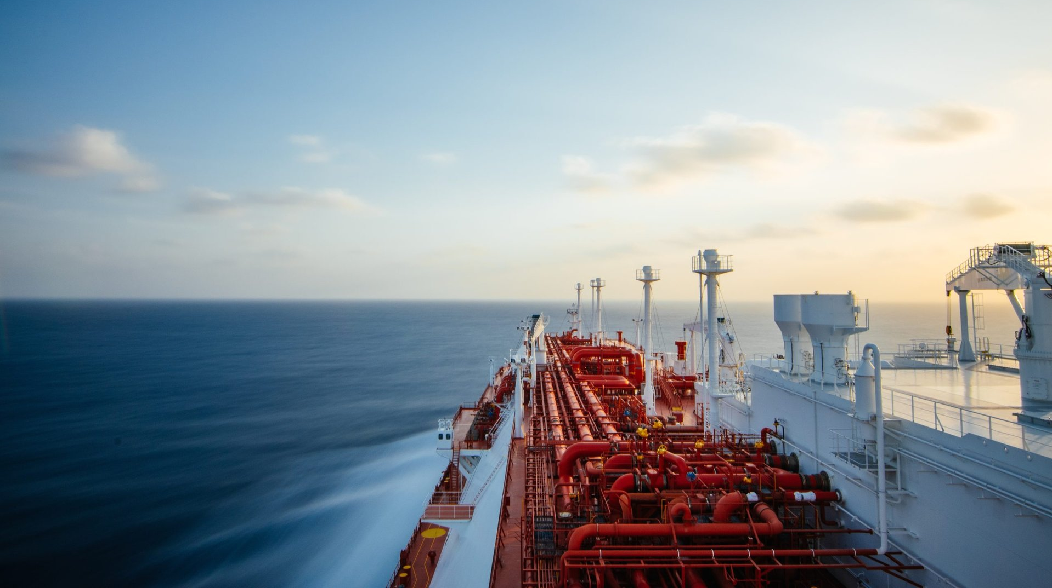
« PREV
CONTENT
NEXT »
Summary & Next Steps
Problem statement, domain, and dataset selection finalized
Loaded and inspected 1,440 records × 10 columns
Verified: no missing values, no duplicates, no label inconsistencies
Engineered 4 new columns and 2 summary tables
10+ visualizations: univariate, bivariate, multivariate
Correlation analysis across distance, fuel, CO₂, efficiency
At least 5 documented insights
Final recommendations for fleet operations
What's done (Tasks 1 & 2)
Coming next (Tasks 3 & 4)
END PRESENTATION

Slide 14
Task 3 : EDA & Visualisation
Approach:
« PREV
CONTENT
NEXT »
Univariate
Bivariate
Multivariate
5 charts
6 charts
5 charts
One variable at a time — histograms, a count plot, and a pie chart to see each field's own distribution.
Two variables together — scatter, box plots, and bar/line charts comparing pairs of fields.
Three or more factors at once — a correlation heatmap, and hue/style-coded scatter, violin, bar, and KDE plots.
Built entirely with Matplotlib and Seaborn functions from the course notes: plt.hist, plt.scatter, plt.pie, plt.bar, plt.plot, sns.histplot, sns.countplot, sns.boxplot, sns.barplot, sns.heatmap, sns.scatterplot, sns.violinplot, sns.kdeplot.
END PRESENTATION

Slide 15
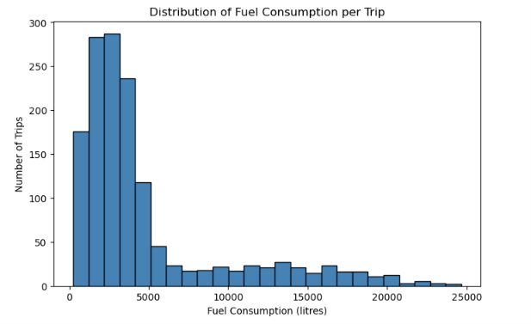
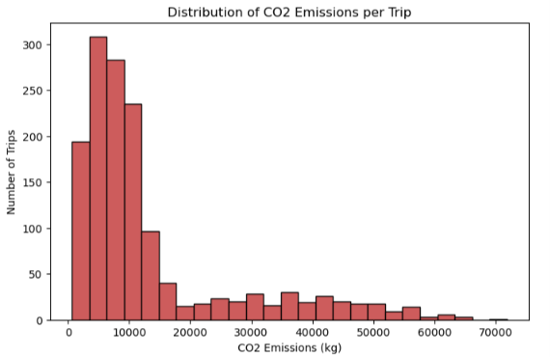
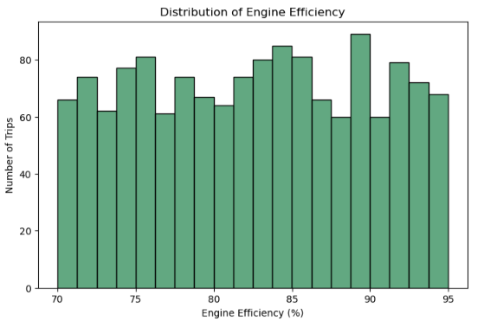
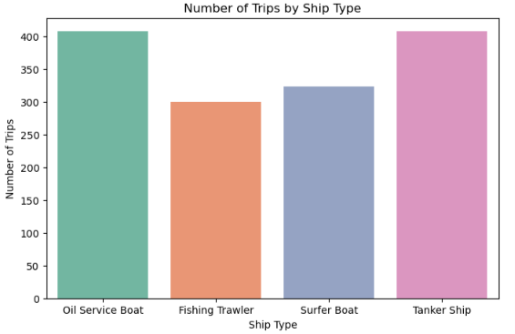
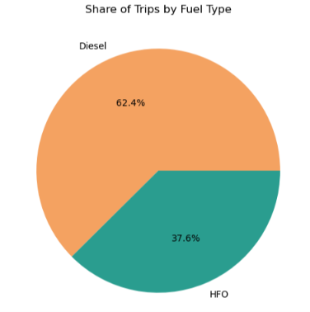
« PREV
CONTENT
NEXT »
Univariate Analysis
END PRESENTATION

Slide 16
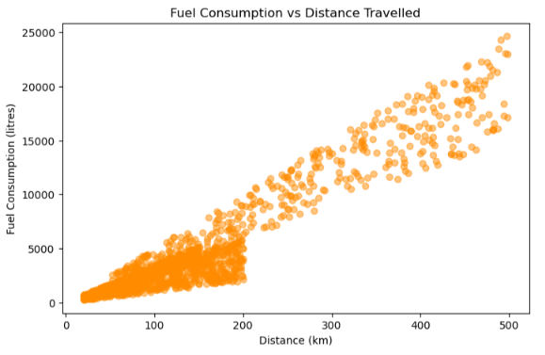
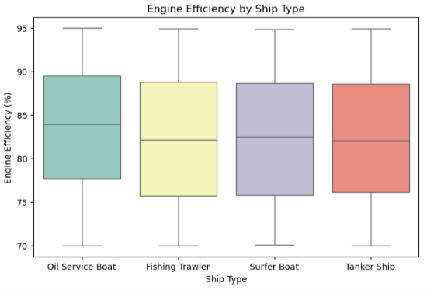
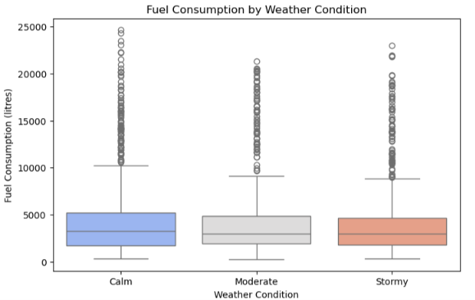
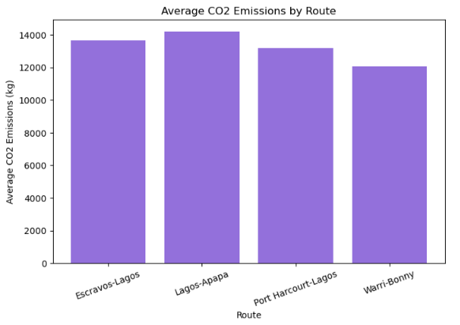
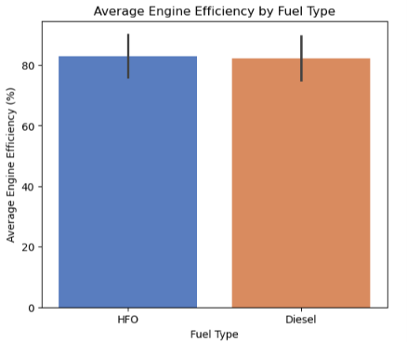
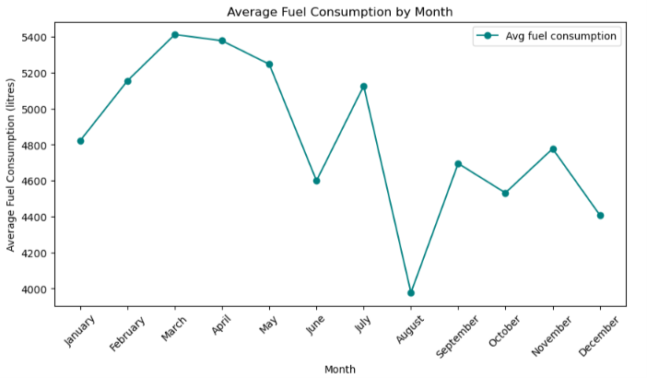
« PREV
CONTENT
NEXT »
Bivariate Analysis
END PRESENTATION

Slide 17
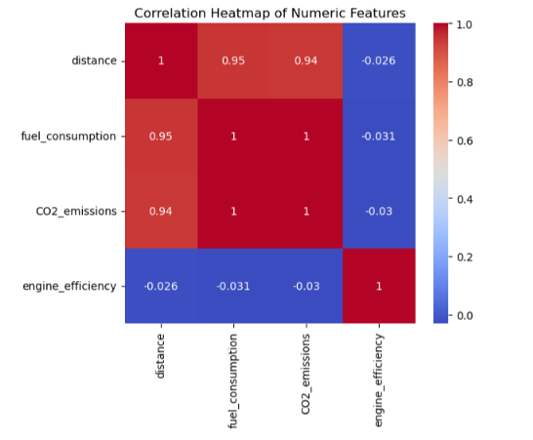
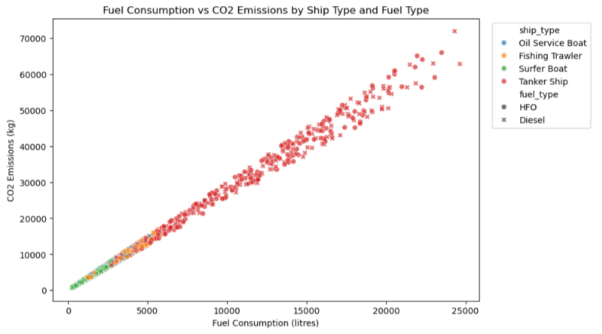
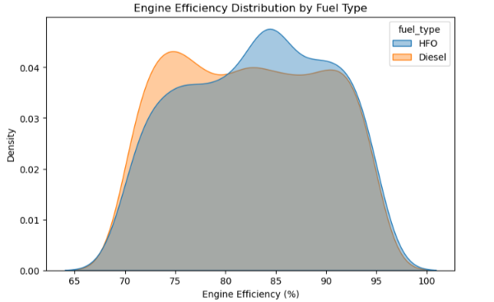
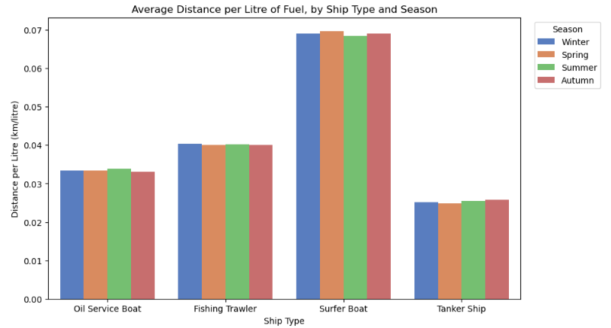
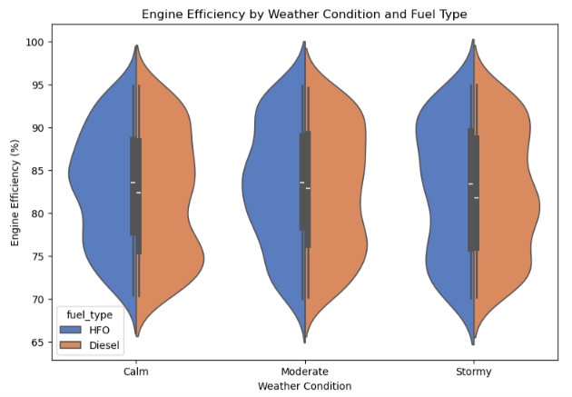
« PREV
CONTENT
NEXT »
Multivariate Analysis
END PRESENTATION

Slide 18
« PREV
CONTENT
TASK 4 »
Task 3 Summary
16
Visualizations built
5+6+5
Univariate + Bivariate + Multivariate
END PRESENTATION
8

Slide 19
« PREV
CONTENT
NEXT »
Task 4: Documentation, Insights & Presentation
END PRESENTATION
Headline Finding: Tanker Ships Drive Fuel & Emissions
Ship Type | Trips | Avg Distance (km) | Avg Fuel (L) | Avg CO₂ (kg) | Avg Efficiency (%)
Tanker Ship | 408 | 266.76 | 10,780.41 | 29,795.44 | 82.18
Fishing Trawler | 300 | 127.64 | 3,229.17 | 8,913.09 | 82.14
Oil Service Boat | 408 | 86.59 | 2,619.44 | 7,187.83 | 83.42
Surfer Boat | 324 | 111.31 | 1,666.13 | 4,577.64 | 82.44
Tankers average ~6.5x the fuel consumption of a Surfer Boat and the highest CO₂ emissions per trip of any ship type in the fleet — the single clearest target for efficiency initiatives.
Built with df.groupby('ship_type').agg(...) — the same aggregation syntax shown in the course notes.

Slide 20
« PREV
CONTENT
NEXT »
Key Insights (1 of 2)
01
Tanker Ships are the fleet's biggest fuel & emissions driver, averaging ~6.5x a Surfer Boat's fuel use per trip.
02
Fuel consumption is almost perfectly correlated with CO₂ emissions (r≈ 0.997) and strongly correlated with distance (r≈ 0.94). Engine efficiency barely correlates with any of them.
03
Weather has only a minor effect here — the Task 3 box and violin plots show Calm/Moderate/Stormy trips are very close on both fuel use and efficiency.
END PRESENTATION

Slide 21
« PREV
CONTENT
NEXT »
Key Insights (2 of 2)
04
HFO's higher average fuel & CO₂ is mostly a ship-assignment effect — Surfer Boats never use HFO, so the two fuels aren't compared like-for-like. Efficiency itself differs by <1 point.
05
CO₂ per litre of fuel is remarkably consistent (≈2.75, std ≈0.15), but CO₂ per km varies nearly 3x by ship type (41 for Surfer Boats vs. 111 for Tankers) — the real lever for cutting emissions.
06
Lagos-Apapa is the highest-emission route on average, narrowly ahead of Escravos-Lagos; Warri-Bonny is the lowest.
END PRESENTATION

Slide 22
« PREV
CONTENT
NEXT
Recommendations & Next Steps
1
Target Tankers & the Lagos-Apapa route first
Prioritize efficiency audits where the data shows the highest emissions — largest absolute savings potential.
2
Control for ship type before comparing fuels
HFO's higher average fuel/CO₂ is confounded by ship assignment (Surfer Boats never use HFO) — compare fuels within a single ship type for a cleaner read.
3
Evaluate fuel switching on cost & emissions, not efficiency
Since fuel type showed little direct effect on engine efficiency once ship type is accounted for, base any HFO→Diesel decision on cost and emissions factors.
4
Investigate what actually drives engine efficiency
It correlates weakly with every numeric field here — likely candidates not in this dataset include vessel age, maintenance history, and engine type.
END PRESENTATION

Slide 23
Ship Fuel Efficiency
& Emissions Analysis
Data Analytics Final Project —
Task 1: Problem Definition & Dataset Selection | Task 2: Data Cleaning & Pre-processing | Task 3: EDA & Visualizations| Task 4: Documentation, Insights & Presentation
START PRESENTATION »
CONTENTS
FILE UNLOCKED
END PRESENTATION
Aseem
Domain: Environmental / Maritime Operations Analytics
Dataset: ship_fuel_efficiency.csv • 1,440 trip records • 10 features

